Slide 1
Eniac needs for A/B testing
Javier, Shravanti, Tejal

Slide 2
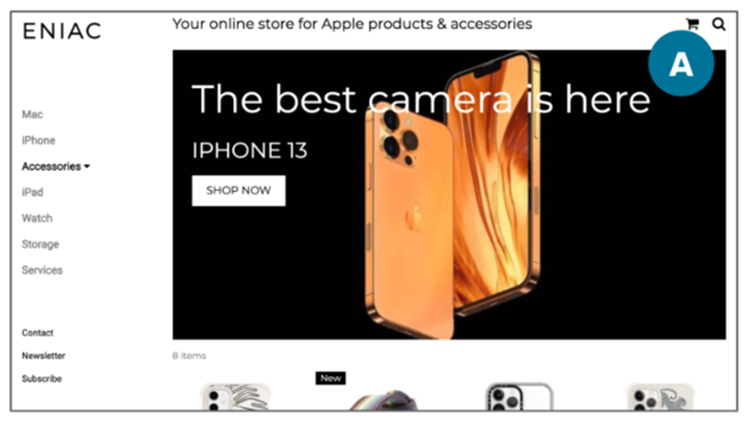
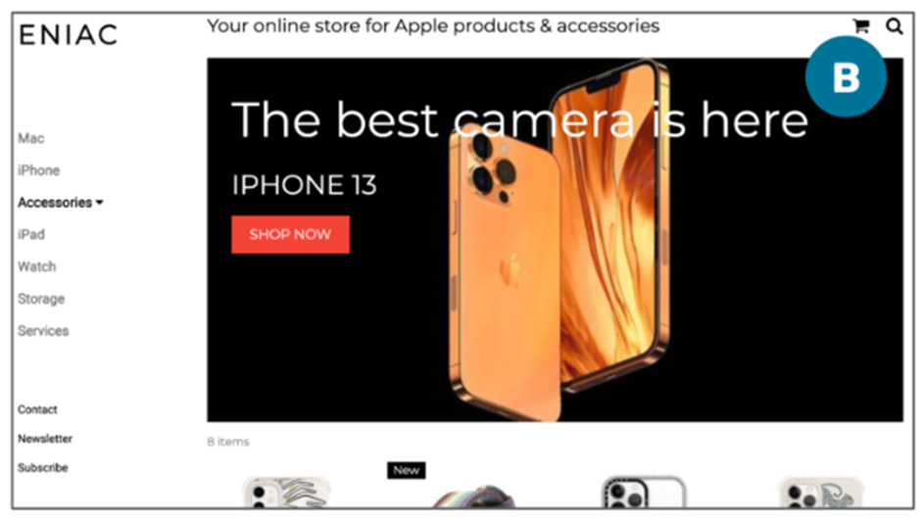
Project analysis slide 2
Versions should be tested
Test
Colour
Call-to-action

Slide 3
Project analysis slide 2
Experiment with other elements
Big “Search bar”
Login button
Shopping cart with catchy colour
Live chat box
Recommendation products
Map button on dashboard

Slide 4
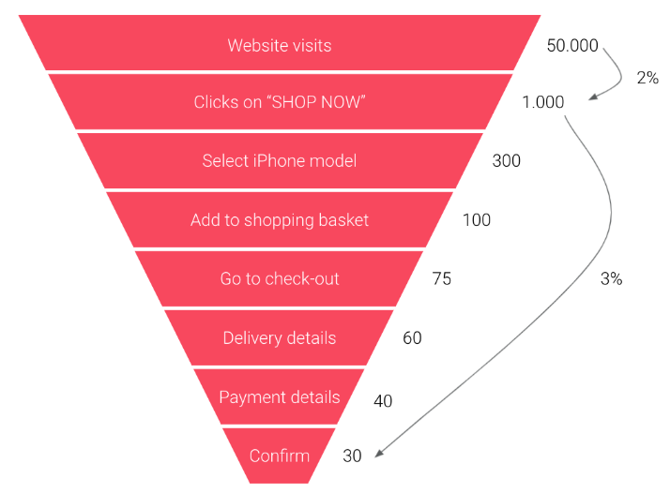
Project analysis slide 2
Conversion Rate Metrics
Purchase funnel for iPhone sales, Oct 11 – Oct 17, 2021

Slide 5
Project analysis slide 2
Analytic Tools
Optimizely
VWO
Convert Experiences
Site Spect
AB Tasty
Evolv
Google Optimize
Qubit
Adobe Target
Marketing Tools With Built-In Testing
Clicks by Chance?
Identifying the visitor by the cookie
source: https://conversionsciences.com/ab-testing-tools/

Slide 6
Project analysis slide 2
Experiment duration
Start
2 Weeks
Analyse
Test low and High traffic
Statistical reliability – 95%-99%
Minimum 5000 visitors

